Slide 1

Google Wave
Joe Gregorio
Developer Relations

Slide 2
Forms
  Forms and Elements

Slide 3
Blip Operations and Elements
Blip Selectors
- all(element|text)
- first()
- at(index)
- range(start, end)
Blip Operations
- insert(element|text)
- insert_after(element|text)
- replace(element|text)
- delete()
- clear_annotation()
- update_element(value)

Slide 4
Elements
Button(name, value)
Check(name, value='')
Gadget(url, props=None)
Image(url='', width=None,
height=None, attachmentId=None, caption=None)
Input(name, value='')
Installer(manifest)
Label(label_for, caption)
Line(line_type=None, indent=None,
alignment=None, direction=None)
Password(name, value)
RadioButton(name, group)
RadioButtonGroup(name, value)
TextArea(name, value)

Slide 5
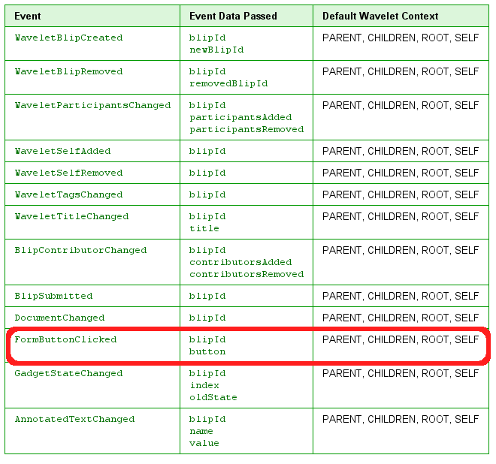
Form Events

Slide 6
Elements
- Event handled on server
- Can be edited/delete by user
- Only added by robot

Slide 7
Exercise
Create a robot that does math.
When added to a wave it adds two inputs and a button. When you press the button it prints the sum of the values in the inputs.
Soution: tutorial5

Slide 8
Thank You
  Questions?

